Slide 1
Sunday Service Connection Grace Episcopal Church
Start Recording
Virtual Worship/
Morning Prayer
First Sunday after the Epiphany
Reverend Grant Barber
Dr. Bob Lambe, Musical Director
Deb Bordne, Marie Fournier, Deborah Whelan, Barbara Hanson & Kay Standifer Cantors
Marge Cull & Bob Lanpher
01.10.21
Notes:
Here are notes

Slide 2
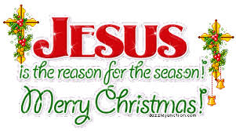
Opening
Officiant’s microphone open, all others muted.
Priest: Blessed be God: Father, Son and Holy Spirit;
People: and blessed be God's kingdom, now and forever. Amen.

Slide 3
Gloria
Glory to God in the highest, and peace to his people on earth.
Lord God, heavenly King, almighty God and Father, we worship you, we give you thanks, we praise you for your glory.
Lord Jesus Christ, only Son of the Father, Lord God, Lamb of God,
you take away the sin of the world: have mercy on us; you are seated at the right hand of the Father: receive our prayer.
For you alone are the Holy One, you alone are the Lord, you alone are the Most High, Jesus Christ, with the Holy Spirit, in the glory of God the Father. Amen

Slide 4
The Collect
Father in heaven, who at the baptism of Jesus in the River Jordan proclaimed him your beloved Son and anointed him with the Holy Spirit: Grant that all who are baptized into his Name may keep the covenant they have made, and boldly confess him as Lord and Savior; who with you and the Holy Spirit lives and reigns, one God, in glory everlasting. Amen.

Slide 5
First Reading – Reader
Reader’s microphone open, all others muted
Genesis 1:1-5
In the beginning when God created the heavens and the earth, the earth was a formless void and darkness covered the face of the deep, while a wind from God swept over the face of the waters. Then God said, “Let there be light”; and there was light. And God saw that the light was good; and God separated the light from the darkness. God called the light Day, and the darkness he called Night. And there was evening and there was morning, the first day.
Hear what the Spirit is saying to God’s people
All: Thanks be to God

Slide 6
Psalm 29 Rev. Grant & Reader
1 Ascribe to the Lord, you gods, * ascribe to the Lord glory and strength.
2 Ascribe to the Lord the glory due his Name; * worship the Lord in the beauty of holiness.
3 The voice of the Lord is upon the waters; the God of glory thunders; * the Lord is upon the mighty waters.
4 The voice of the Lord is a powerful voice; * the voice of the Lord is a voice of splendor.
5 The voice of the Lord breaks the cedar trees; * the Lord breaks the cedars of Lebanon;
continued

Slide 7
continue
6 He makes Lebanon skip like a calf, * and Mount Hermon like a young wild ox.
7 The voice of the Lord splits the flames of fire; the voice of the Lord shakes the wilderness; * the Lord shakes the wilderness of Kadesh.
8 The voice of the Lord makes the oak trees writhe * and strips the forests bare.
9 And in the temple of the Lord * all are crying, "Glory!“
10 The Lord sits enthroned above the flood; * the Lord sits enthroned as King for evermore.
11 The Lord shall give strength to his people; * the Lord shall give his people the blessing of peace.

Slide 8
Second Reading – Rev. Grant Barber
Grant or Reader’s microphone open, all others muted
Mark 1:4-11
Glory to you O Lord
John the baptizer appeared in the wilderness, proclaiming a baptism of repentance for the forgiveness of sins. And people from the whole Judean countryside and all the people of Jerusalem were going out to him, and were baptized by him in the river Jordan, confessing their sins. Now John was clothed with camel’s hair, with a leather belt around his waist, and he ate locusts and wild honey. He proclaimed, “The one who is more powerful than I is coming after me; I am not worthy to stoop down and untie the thong of his sandals. I have baptized you with water; but he will baptize you with the Holy Spirit.”
In those days Jesus came from Nazareth of Galilee and was baptized by John in the Jordan. And just as he was coming up out of the water, he saw the heavens torn apart and the Spirit descending like a dove on him. And a voice came from heaven, “You are my Son, the Beloved; with you I am well pleased.”
Praise to you Lord Christ

Slide 9
The Nicene Creed
Rev Grant’s microphone open, all others muted
We believe in one God, the Father, the Almighty, maker of heaven and earth, of all that is, seen and unseen.
We believe in one Lord, Jesus Christ, the only Son of God, eternally begotten of the Father, God from God, Light from Light, true God from true God, begotten, not made, of one Being with the Father. Through him all things were made. For us and for our salvation he came down from heaven: by the power of the Holy Spirit he became incarnate from the Virgin Mary,
and was made man.
For our sake he was crucified under Pontius Pilate; he suffered death and was buried. On the third day he rose again in accordance with the Scriptures; he ascended into heaven and is seated at the right hand of the Father
He will come again in glory to judge the living and the dead, and his kingdom will have no end.
We believe in the Holy Spirit, the Lord, the giver of life, who proceeds from the Father and the Son. With the Father and the Son he is worshiped and glorified. He has spoken through the Prophets.
We believe in one holy catholic and apostolic Church. We acknowledge one baptism for the forgiveness of sins.
We look for the resurrection of the dead, and the life of the world to come.
Amen

Slide 10
Prayers of the People - Form II – Reader
In the course of the silence after each bidding, the People offer their own prayers, either silently or aloud.
I ask your prayers for God's people throughout the world; for our Presiding Bishop Michael, our Bishops Alan and Gayle; for this gathering; and for all ministers and people. Pray for the Church.
Silence
I ask your prayers for peace; for goodwill among nations; and for the well-being of all people. Pray for justice and peace.
Silence
I ask your prayers for the poor, the sick, the hungry, the oppressed, and those in prison. Pray for those in any need or trouble.
Dot B., Marilyn W., Kyle M., Jennifer M., Claire M., Muriel C., Daniel, Marjorie S., Tom D., JoAnn B., Vi G., Andrew D., Loren C., Richard T., Pat N., Rebecca T., Stephanie T., David T., George M., Alison S., Diane M., Carolyn D., John V., Norm L., Fredy V., Janet D., Beth W., Ron, Nancy M., Michele T., Bob B. & Carole HP

Slide 11
Prayers of the People –
Rev. Grant or reader’s microphone is open, all others muted
We give thanks for those serving in the military, especially: Matt C., Baron S., Zachary S., Christopher, Tim, Monique & Joey
I ask your prayers for all who seek God, or a deeper knowledge of him. Pray that they may find and be found by him.
Silence - We invite you to name out loud others we pray for….
I ask your prayers for the departed. Pray for those who have died.
Silence - We invite you to name out loud others we pray for….
I ask for your prayers of thanksgiving for blessings. Pray in gratitude to God.
Silence - We invite you to name out loud thanksgivings we pray for….
You may also add your prayers in the chat box, including birthday or anniversary remembrances.

Slide 12
Confession and Absolution
Let us confess our sins against God and our neighbor
Officiant and People together
Most merciful God, we confess that we have sinned against you in thought, word, and deed, by what we have done, and by what we have left undone. We have not loved you with our whole heart; we have not loved our neighbors as ourselves. We are truly sorry and we humbly repent. For the sake of your Son Jesus Christ, have mercy on us and forgive us; that we may delight in your will, and walk in your ways, to the glory of your Name. Amen.
Priest: Almighty God have mercy on you, forgive you all your sins through our Lord Jesus Christ, strengthen you in all goodness, and by the power of the Holy Spirit keep you in eternal life.
Amen.

Slide 13
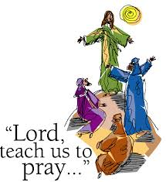
The Lord’s Prayer Mute microphones
And now, as our Savior Christ has taught us, we are bold to say,
Our Father, who art in heaven,
hallowed be thy Name,
thy kingdom come,
thy will be done,
on earth as it is in heaven.
Give us this day our daily bread.
And forgive us our trespasses,
as we forgive those who trespass against us.
And lead us not into temptation,
but deliver us from evil.
For thine is the kingdom, and the power,
and the glory, for ever and ever.
Amen.

Slide 14
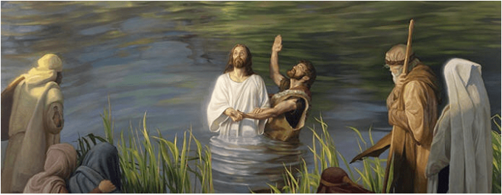
Closing
Officiant:
Let us bless the Lord.
Alleluia, alleluia
People:
Thanks be to God!
Alleluia, Alleluia

